Slide 1






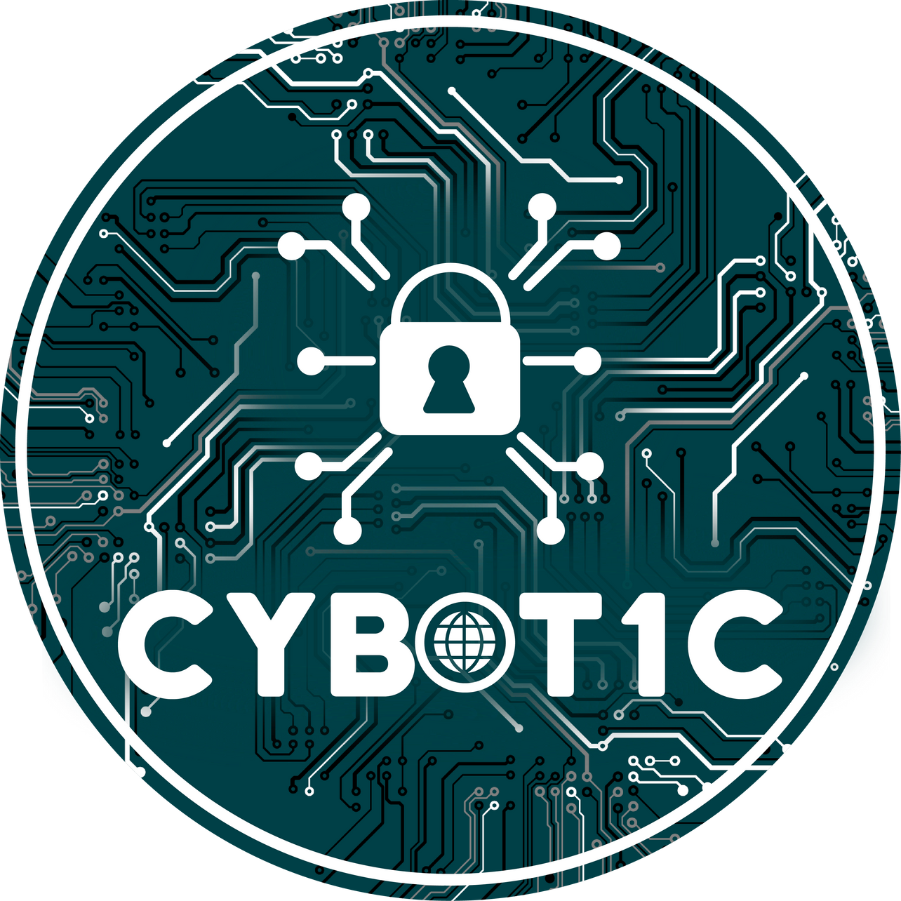
MANGALORE INSTITUTE OF TECHNOLOGY & ENGINEERING
(A Unit of Rajalaxmi Education Trust®, Mangalore - 575001)
Autonomous Institute affiliated to V.T.U., Belagavi, Approved by AICTE, New Delhi Accredited by NAAC with A+ Grade, & ISO 9001:2015 Certified Institution
151-300
DEPARTMENT OF CSE (IoT & Cyber Security with Blockchain Technology)
CODE CREST
Bid Build Break
TEAM NAME :
Team Lead Name:

Slide 2


01
02
03
Problem Statement
Solution
Methodology
04
05
Market Research
Conclusion
Agenda

Slide 3
Problem statement

Slide 4
Solution

Slide 5
Methodology

Slide 6
Market Research

Slide 7
Conclusion

Slide 8
Thank
you

